Slide 1
Measuring Charter School Financial Viability: A Better Approach
CCSA Annual Conference
Tuesday March 27, 2018
Welcome

Slide 2
Presenters
David Patterson Ed.D., Director CARSNet (Charter Authorizers Regional Support Network)
Brianna Garcia, Director, Management Consulting Services, School Services of California (SSC)
Darlene Chambers, Ph.D., Senior Vice President National Charter Schools Institute
Debi Deal, CFE Intervention Specialist, FCMAT (Fiscal Crisis & Management Assistance Team)
Miles Denniston, Vice President, CSMC (Charter School Management Corporation)

Slide 3
What is CARSNet? What is CCAP?

Slide 4
Outcomes for the Workshop
Participants Have an Understanding:
Why fiscal viability is critical
What are fiscal leading indicators
Leading indicators developed by CARSNet
Discussion and your feedback

Slide 5
Why is charter financial oversight critical?
According to the Center for Education Reform, 42% of charter school closures can be attributed to financial deficiencies.

Slide 6
What’s In Ed Code?
EC 47604.32: Each chartering authority…shall do all of the following with respect to each charter school under its authority:
…(d) Monitor the fiscal condition of each charter school under its authority

Slide 7
CARSNet Undertook Identifying Fiscal Metrics that Work for California Charter Schools
Values, Principles and Expectations
Design Principles
Authorizers in CA, NACSA, FCMAT, School Services
Guidance from NACSA, standards being used in other states

Slide 8
Three Categories of Accountability Metrics - 1
Near-Term Measures, Sustainability and Financial Compliance
These are leading indicators for the school
Work ongoing to consolidate further

Slide 9
Measure | Metric
Near-Term Measures
1.a | Current ratio
1.b | Unrestricted days cash on hand
1.c | Enrollment variance
1.d | Unduplicated pupil percentage (UPP) variance
1.e | Default
Sustainability Measures
2.a | Total margin
2.b | Debt to asset ratio
2.c | Cash flow monitoring
2.d | Debt service coverage ratio
2.e | Minimum Proportionality Percentage (MPP)
Financial Compliance Measures
3.a | Financial reporting and compliance requirements
3.b | Generally Accepted Accounting Principles (GAAP)

Slide 10
Working Smarter, Not Harder
Using Technology to Make Fiscal Reporting More Timely, Efficient and Transparent
Epicenter

Slide 11
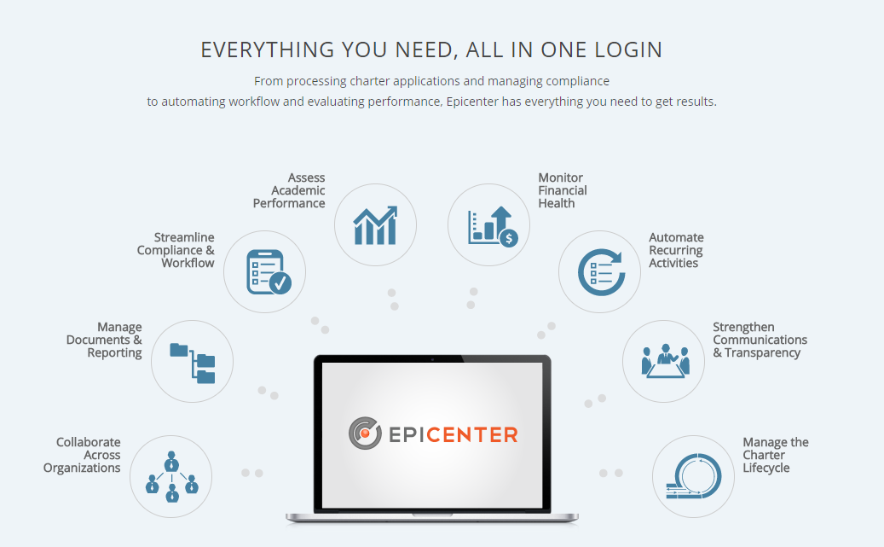

Slide 12
Epicenter Scorecard: Financial Oversight and Monitoring
Automatically scores defined financial targets
Only the Scorecard provides trend data
Populates data in Annual Reports
Centrally stores and delivers transparent data
At a glance, provides a portfolio view

Slide 13
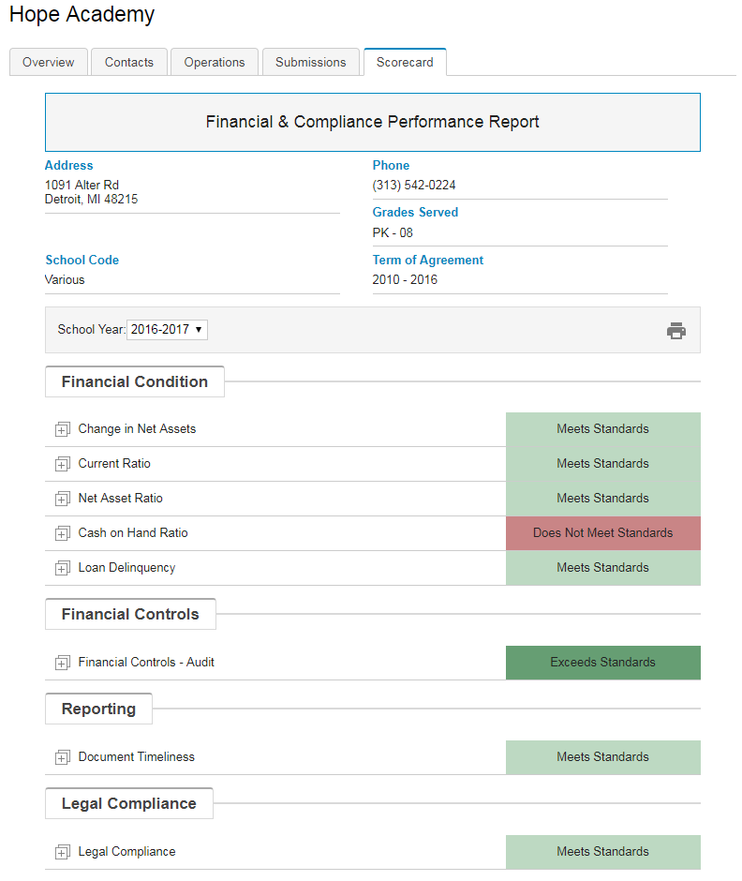

Slide 14
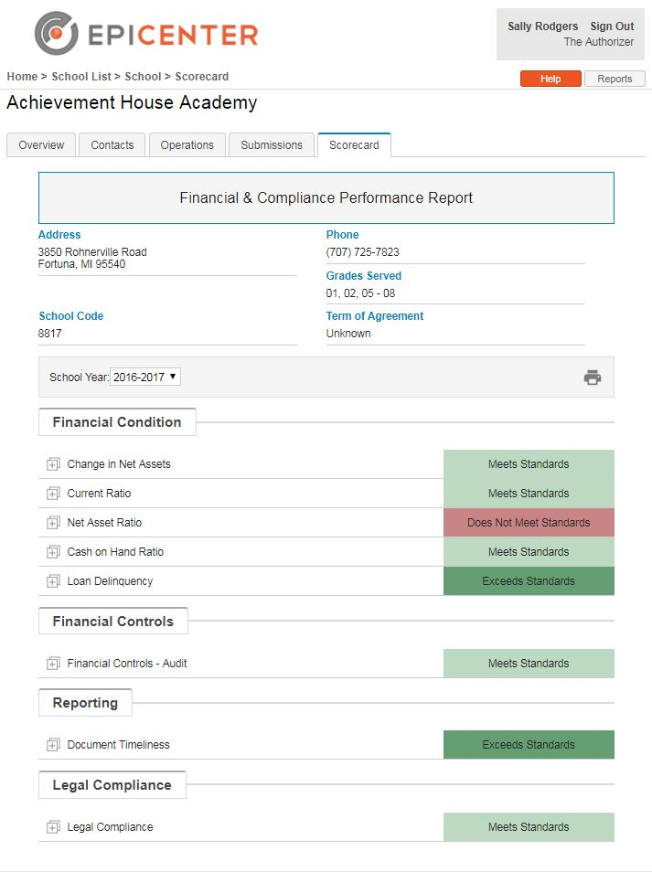
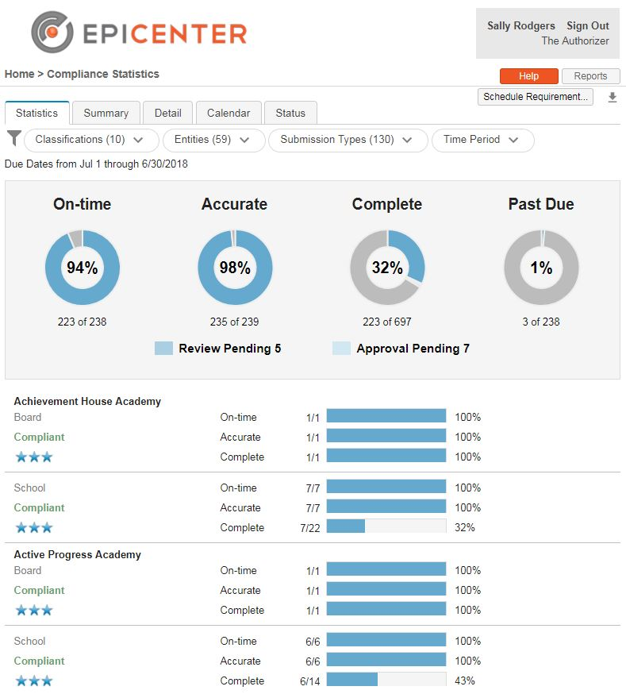
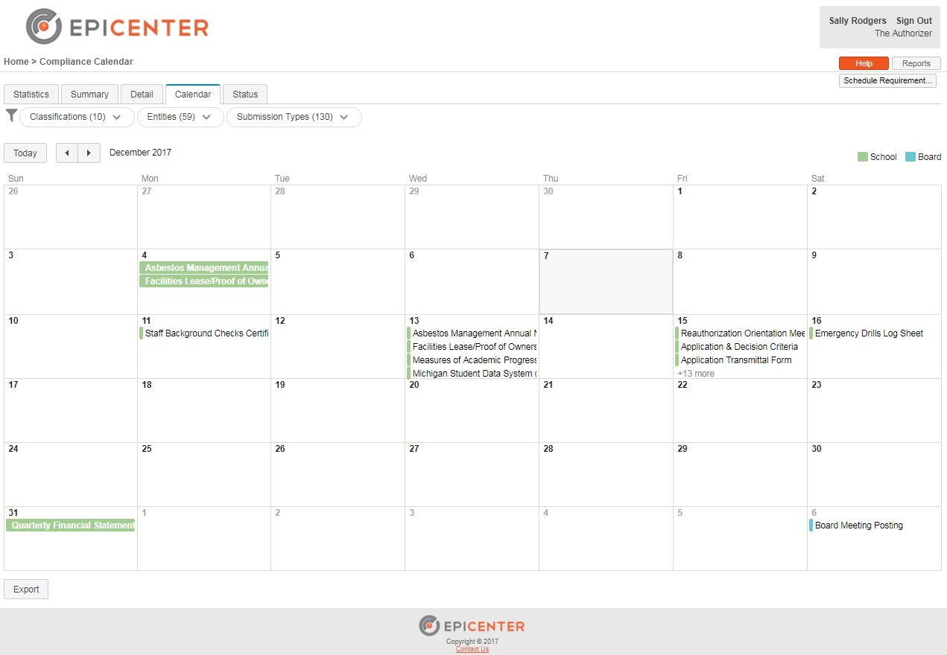
Epicenter – Quick Overview On-Line Document Management and Oversight Tool

Slide 15
Panel Discussion Your Questions and Input - 1
Panelists
Miles Denniston - Vice President, CSMC (Charter School Management Corporation)
Debi Deal – CFE – Intervention Specialist, FCMAT (Fiscal Crisis & Management Assistance Team)

Slide 16
Panel Discussion Your Questions and Input - 2
Leading Questions
How will fiscal metrics and ratios help the school and the authorizer identify when a school is doing well, is facing fiscal pressures, or is at serious risk of failure?
How effective do you think small charter schools and small authorizers can be in using these fiscal metrics and ratios?
What are the two top things CARSNet, CCAP and the authorizing community should be considering in further developing and implementing these standards?

Slide 17
Additional Resources
CARSNet Website
www.carsnet.org
CCAP Website
www.calauthorizers.org

Slide 18
Contact Information
David Patterson Ed.D., Director CARSNet (Charter Authorizers Regional Support Network)
dpatterson@acoe.org
916-801-2454
Brianna Garcia, Director, Management Consulting Services, School Services of California (SSC)
briannag@sscal.com
916-446-7517
Darlene Chambers, Ph.D., Senior Vice President National Charter Schools Institute
dchambers@charternstitute.org
989-317-3510
Debi Deal, CFE Intervention Specialist, FCMAT (Fiscal Crisis & Management Assistance Team)
ddeal@fcmat.org
661-802-0228
Miles Denniston, Vice President, CSMC (Charter School Management Corporation)
mdenniston@csmci.com
510-846-2174

