Slide 1


Charter Considerations
Strategic thinking for initial petition submissions, appeals, renewals, and renewal appeals

Slide 2
Welcome!
Brian Bauer: Executive Director of Granada Hills Charter High School, California State Board's Advisory Commission on Charter Schools (ACCS)
Carolyn Pfister: State Board of Education Staff, Lead on Charter Issues
Dr. Nicole Assisi: CEO and Founder of Thrive Public Schools

Slide 3
Authorization
Most charter schools are expected to be locally authorized
District
County
SBE
If the school district denies a petition, an appeal may be made to the county board of education.
If the county denies the petition, and appeal may be made to the State Board.

Slide 4
Charter School Authorizing in California

Slide 5
SBE-Authorized Charter School Successes
Seventeen SBE-Authorized Charter Schools have sought renewal one or more times since January 2011.
Twelve have been locally renewed and a 13th will be locally authorized beginning in July.

Slide 6
How to Prepare for State Review
Timing
Relationships
Petition
Statute and Regulations
New Requirements of Law
Facilities

Slide 7
Timing Your Submission
Recommend submitting three months prior to the desired State Board of Education Meeting
State Board of Education Schedule http://www.cde.ca.gov/be/mt/st/
Submission Timeline http://www.cde.ca.gov/sp/cs/re/sbeappeals.asp
State Board Meeting | Submission Due
July 2017 | April 3, 2017
September 2017 | June 1, 2017
November 2017 | August 1, 2017

Slide 8
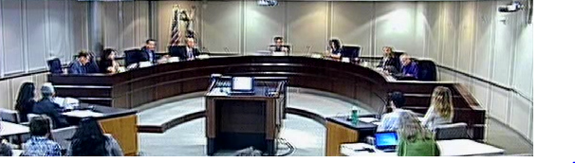
Advisory Commission on Charter Schools
Commission Composition
Meeting schedule and format
Stakeholder groups
Commission recommendations

Slide 9
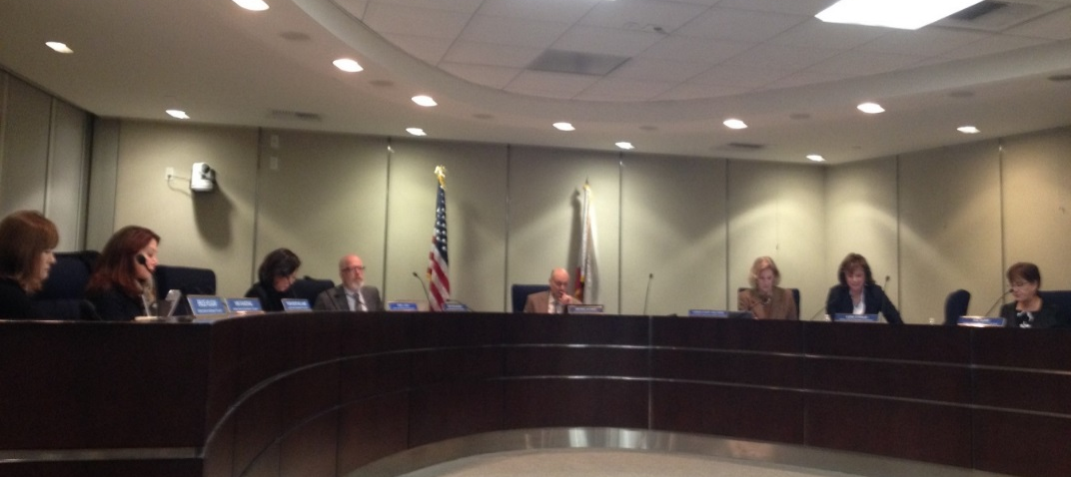
State Board of Education
Charter liaisons
Public hearings
Meeting preparation

Slide 10

Public Hearings and Presentations
What to expect at the ACCS and SBE meetings
De Novo Review
Substantive Changes – vs- Technical Changes
Addressing CDE’s findings

Slide 11
Select Education Code and Code of Regulations
For Renewals
For New Schools
EC or 5 CCR | As Pertains to:
EC 47605 | Charter petition process and requirements, approval and denial
EC 47607 | Renewal criteria
EC 47607.5 | Renewal aligned with subdivision (j) of EC 47605
5 CCR 11966.4 | Renewal submissions to districts
5 CCR 11966.5 | Renewal submissions to County
5 CCR 11966.6 | Renewal submissions to the SBE
5 CCR 11967.5.1 | SBE criteria for review and approval
EC or 5 CCR | As Pertains to:
EC 47605 | Charter petition process and requirements, approval and denial
5 CCR 11967 | Appeals (timing and submission requirements)
5 CCR 11967.5 | Review and approval by the SBE
5 CCR 11967.5.1 | SBE criteria for initial and renewal petitions

Slide 12
SBE Appeals for New Schools
A copy of the petition as denied
Signatures
Evidence of the district and county board’s denial (minutes)
District and county factual findings / petitioner’s responses
Signed assurances to comply with applicable law
Changes to the petition needed to reflect the State Board of Education as authorizer
Notes:
Appeals for new schools: A copy of the petition as denied
Signatures
Evidence of the district and county board’s denial (minutes)
District and county factual findings / petitioner’s responses
Signed assurances to comply with applicable law
Changes to the petition needed to reflect the State Board of Education as authorizer
Requirements for renewal appeals:
Documentation that the school met at least one of the renewal criteria
A copy of the renewal petition, as denied
Evidence of the district’s denial and copy of written factual findings
Evidence of the county’s denial and copy of written factual findings or if the county took no action, evidence that the timeline has expired
Changes to the renewal petition needed to reflect the State Board of Education as authorizer
Renewal Appeals

Slide 13
SBE Appeals for Charter Renewal
Documentation that the school met at least one of the renewal criteria
A copy of the renewal petition, as denied
Evidence of the district’s denial and copy of written factual findings
Evidence of the county’s denial and copy of written factual findings or if the county took no action, evidence that the timeline has expired
Changes to the renewal petition needed to reflect the State Board of Education as authorizer

Slide 14
Resources
Submitting an appeal to the State Board of Education:
  http://www.cde.ca.gov/sp/cs/re/sbeappeals.asp
  ACCS Meeting Archive:
http://www.cde.ca.gov/be/cc/cs/accswbcst.asp
http://www.cde.ca.gov/be/cc/cs/accswbcstrchv.asp
SBE Meeting Archive:
http://www.cde.ca.gov/be/ag/ag/sbewebcastarchive.asp
Notes:
Appeals for new schools: A copy of the petition as denied
Signatures
Evidence of the district and county board’s denial (minutes)
District and county factual findings / petitioner’s responses
Signed assurances to comply with applicable law
Changes to the petition needed to reflect the State Board of Education as authorizer
Requirements for renewal appeals:
Documentation that the school met at least one of the renewal criteria
A copy of the renewal petition, as denied
Evidence of the district’s denial and copy of written factual findings
Evidence of the county’s denial and copy of written factual findings or if the county took no action, evidence that the timeline has expired
Changes to the renewal petition needed to reflect the State Board of Education as authorizer
Renewal Appeals

Slide 15
Brian Bauer bbauer@ghchs.com
818.360.2361 Ext. 322
Nicole T. Assisi nassisi@thriveps.org
619.839.9543
Carolyn Pfister cpfister@cde.ca.gov
916.319.0399
Questions?

