Slide 1

HOW TO REPLICATE A
SUCCESSFUL CHARTER SCHOOL
Rex Fortune

Slide 2
FOCUS OF THIS PRESENTATION
Evidence of the Achievement Gap
Can the Achievement Gap be bridged?
Charter Schools that bridged the
Achievement Gap
Replicating a successful Charter School

Slide 3
INSTRUMENTS THAT ILLUSTRATE THE ACHIEVEMENT GAP
National Assessment of Educational Progress (NAEP)
California Academic Performance Index (API)
California Standards Tests (CST)

Slide 4
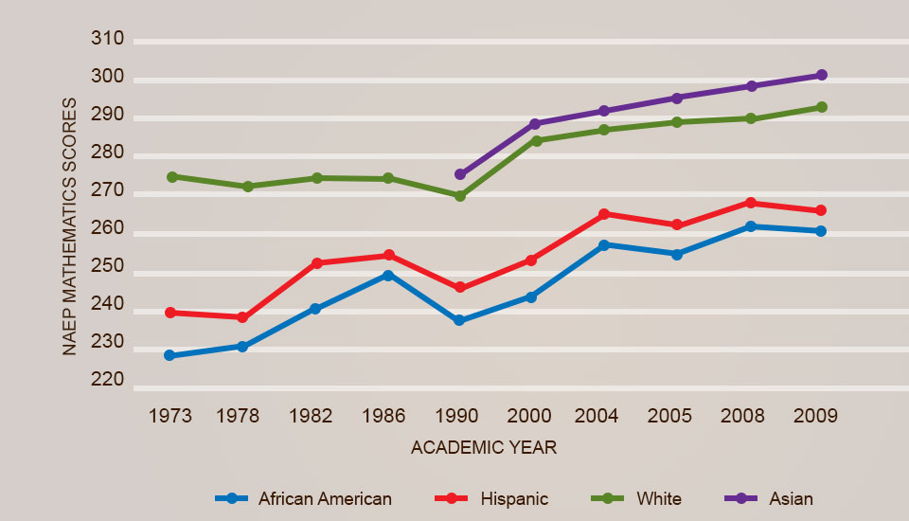
NAEP Mathematics Trends – Grade 8
Source: http://nces.ed.gov/nationsreportcard/mathematics

Slide 5
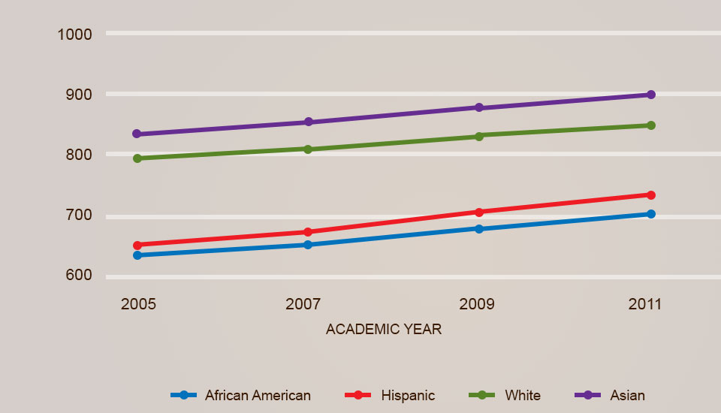
CALIFORNIA ACADEMIC PERFORMANCE INDEX SCORES FOR ASIAN, WHITE, HISPANIC AND AFRICAN AMERICAN STUDENTS
Source: API Base State Reports 2005-2011 CA Department of Education

Slide 6
2010 API SCORES – STATEWIDE DATA All Grades
890
838
715
686
767
Source: Derived from California Department of Education website (www.cde.ca.gov)

Slide 7
SELECTION CRITERIA
> 800 Academic Performance Index
> 70% students proficient or advanced in mathematics in at least one grade level
> 50% of students who qualified for free/reduced priced lunch (indicator of low-income)
Numerically significant ethnic minority enrollment
> 20% African American or
> 40% Hispanic American students

Slide 8
High Minority, Gap Closing Schools that Meet/Exceed CA 800 API Goal
 | School | 2010 API | % Afr. Am. | % Hisp. | % FRPM
1 | Sixth Street Prep. (K-8) | 960 | 6% | 84% | 86%
2 | Oakland Charter Academy (6-8) | 954 | 3% | 92% | 95%
3 | Richardson Prep. (6-8) | 948 | 13% | 64% | 76%
4 | St. HOPE (PS 7) (K-8) | 913 | 78% | 8% | 62%
5 | Wilder' Prep (K-8) | 892 | 87% | 12% | 78%
6 | Victoriano Elementary (K-5) | 891 | 23% | 50% | 62%
7 | Laurel Street Elementary (K-5) | 888 | 17% | 78% | 89%
8 | Charles Bursch Elementary (K-5) | 884 | 29% | 70% | 82%
9 | Vista Magnet Middle (6-8) | 884 | 3% | 48% | 51%
10 | Harbor Teacher Prep. (9-12) | 884 | 25% | 53% | 64%
11 | Merced Elementary (K-5) | 878 | 5% | 73% | 68%
12 | Arroyo Seco Museum Science (K-8) | 869 | 2% | 87% | 100%
13 | Mary McLeod Bethune Elementary (K-5) | 868 | 24% | 57% | 82%
14 | Willard Elementary (K-5) | 863 | 8% | 65% | 65%
15 | Watts Learning Center (K-5) | 860 | 92% | 7% | 91%
16 | Think College Now (K-5) | 859 | 13% | 68% | 93%
17 | Highland Elementary (K-5) | 852 | 48% | 49% | 87%
18 | Otay Elementary (K-6) | 846 | 3% | 53% | 77%
19 | Harborside Elementary (K-6) | 838 | 4% | 54% | 82%
20 | Kelso Elementary (K-6) | 802 | 38% | 59% | 86%
 | Mean | 882 | 26% | 57% | 79%
 | Range | 802-960 | 2-92% | 7-96% | 51-100%

Slide 9
SCHOOL CASE STUDIES
Oakland Charter Academy
Wilder’s Preparatory Academy
Watts Learning Center
St. HOPE Public School 7
Fortune Schools

Slide 10
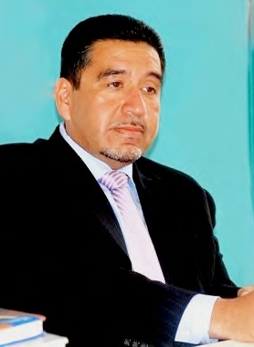
Oakland Charter Academy (6-8) Oakland, California (pp. 26-36)
Total Enrollment: 145
Hispanic: 92%
2010 API: 954
Statewide Rank: 10
Similar Schools Rank: 10
Made AYP
Mr. Jorge Lopez, principal

Slide 11
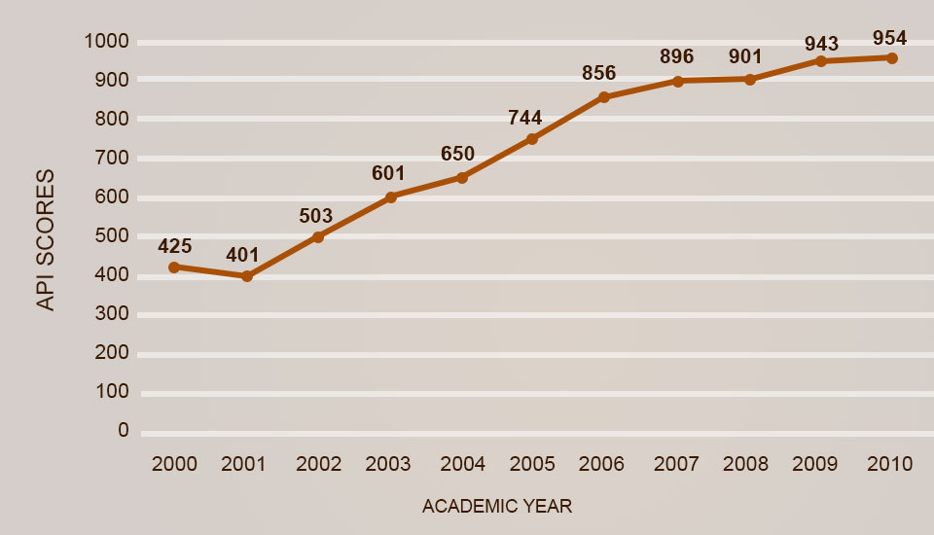
Oakland
Charter Academy
ACADEMIC PERFORMANCE INDEX (API) SCORES

Slide 12
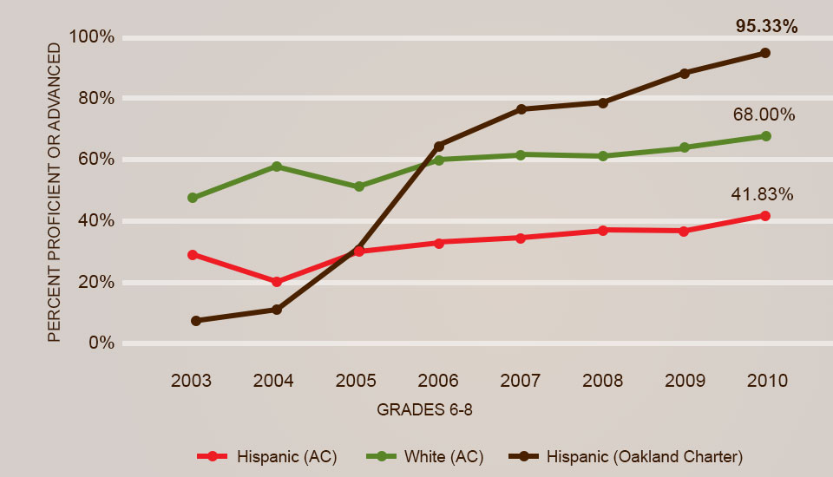
Oakland
Charter Academy
Oakland Charter Academy students scored lower than White and Hispanic students in Alameda County in mathematics in 2003. However, they exceeded the performance of both groups in 2006 and have continued to do so since then.

Slide 13
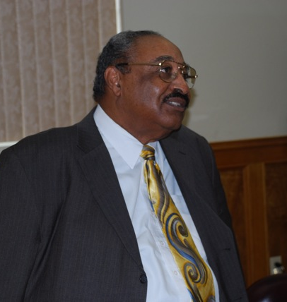
WILDER’S PREPARATORY ACADEMY K-8 CHARTER SCHOOL (2002) Inglewood, California
Total Enrollment: 568
African American: 87%
2010 API: 930 (elementary)
857 (middle)
African American API:
930(elementary)
857 (middle)
Statewide Rank: 8
Similar Schools Rank: 10
Made AYP
Mr. Raymond Wilder, Founder

Slide 14
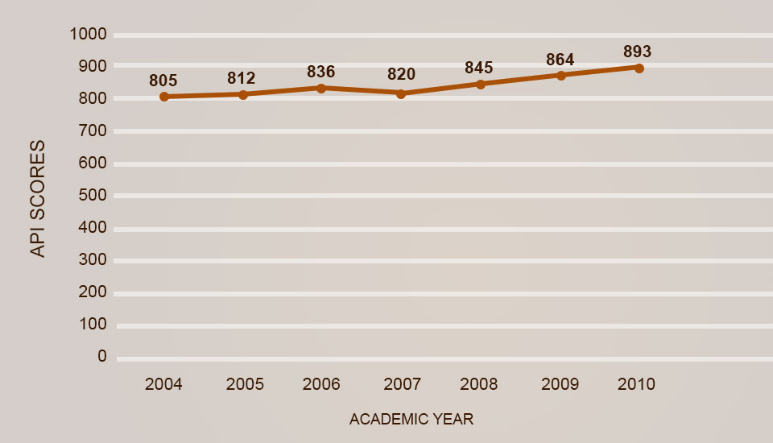
Wilder’s Preparatory
Academy
ACADEMIC PERFORMANCE INDEX (API) SCORES

Slide 15
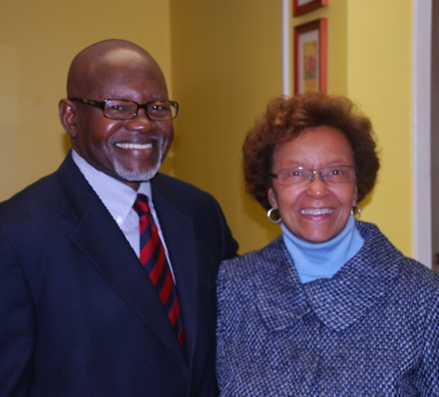
WATTS LEARNING CENTER K-6 CHARTER SCHOOL (1997) Los Angeles, California
Total Enrollment: 367
African American: 92%
API: 860 in 2010
African American API: 858
Statewide Rank: 6
Similar Schools Rank: 10
Made AYP
Mr. & Mrs. Eugene Fisher, Founders

Slide 16
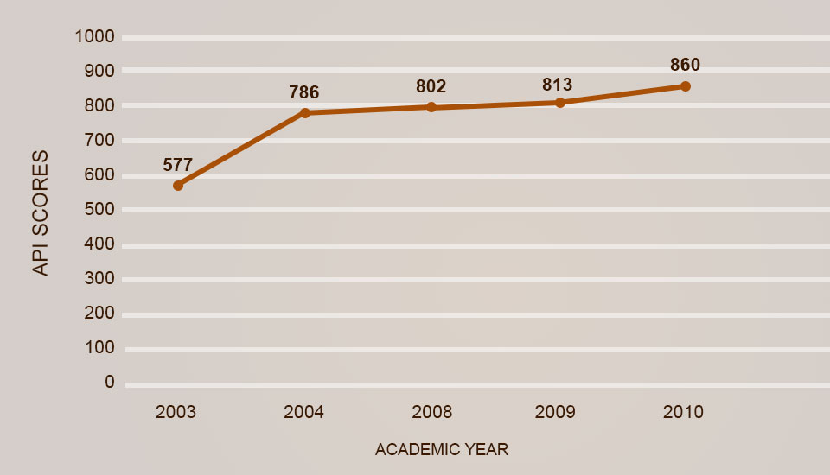
Watts Learning
Center
ACADEMIC PERFORMANCE INDEX (API) SCORES

Slide 17
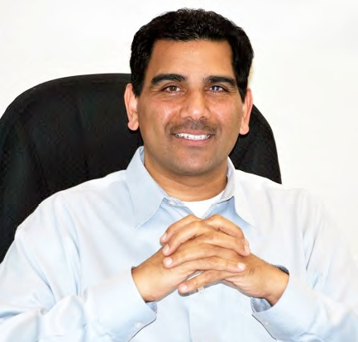
St. HOPE Public School 7 (PS7) K-8 Charter School (2003) Sacramento, California (pp. 47-63)
Total Enrollment: 375
African American: 78%
2010 API: 913
African American API: 908
Statewide Rank: 9
Similar Schools Rank: 10
Made AYP
Mr. Herinder Pegany, founding principal

Slide 18
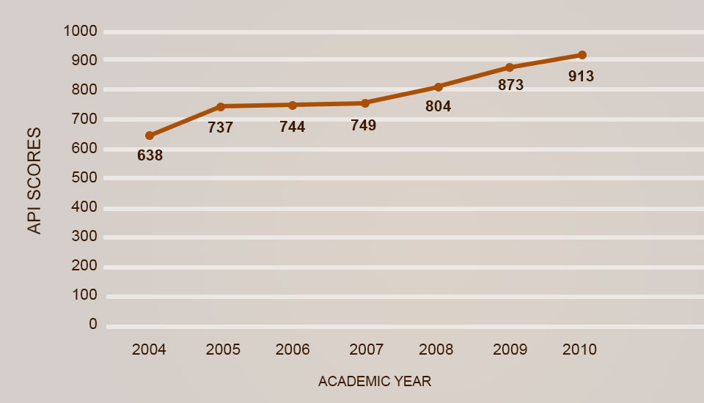
St. HOPE PS 7
ACADEMIC PERFORMANCE INDEX (API) SCORES

Slide 19
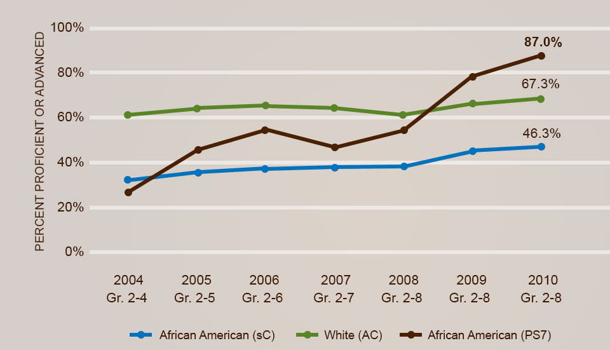
St. HOPE PS 7
AFRICAN AMERICAN ACHIEVEMENT GAP - MATHEMATICS

Slide 20
SCALING UP: A CASE IN POINT
The Fortune School of Education (FSE) Story
FSE adopts PS 7 Model for replication
FSE replicates PS7 model at Hardy Brown College Prep – 2010
FSE replicates HBCP model at Fortune School – 2011
FSE replicates HBCP model at William Lee College Prep – 2012
FSE replicates HBCP model at Alan Rowe College Prep – 2013
FSE replicates HBCP model at Ephraim Williams College Prep – 2014

Slide 21
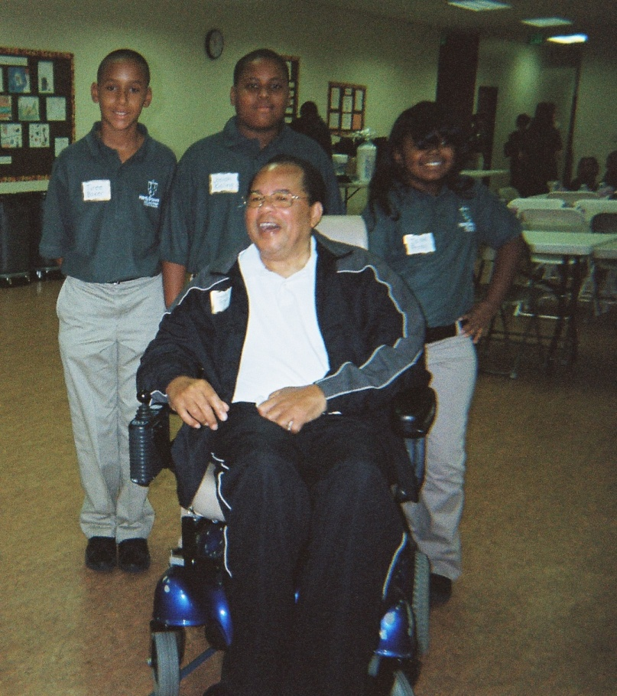
HARDY BROWN COLLEGE PREP
API: 802 (2013)

Slide 22

Hardy Brown
College Prep

Slide 23
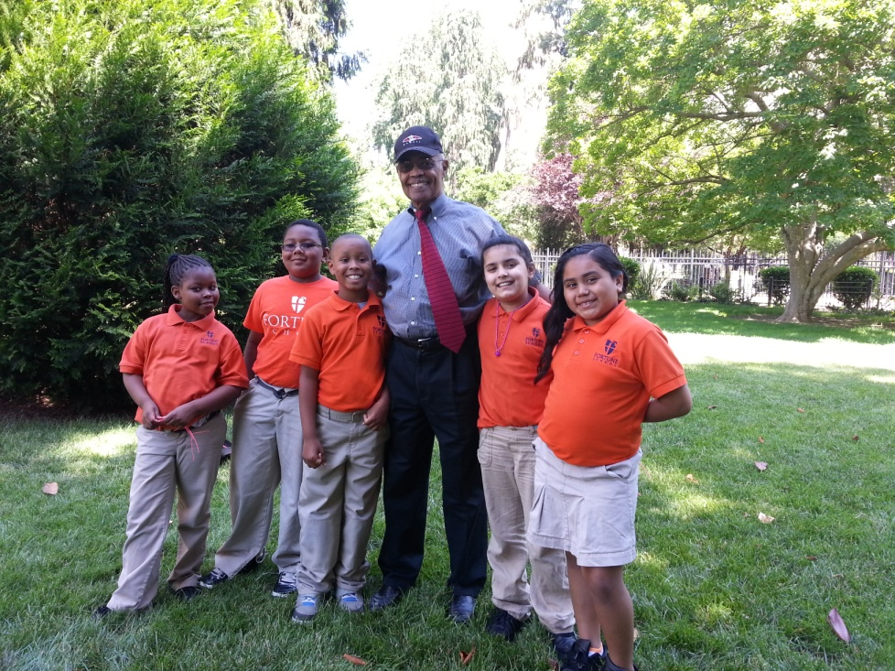
FORTUNE SCHOOL
API: 807 (2013)

Slide 24

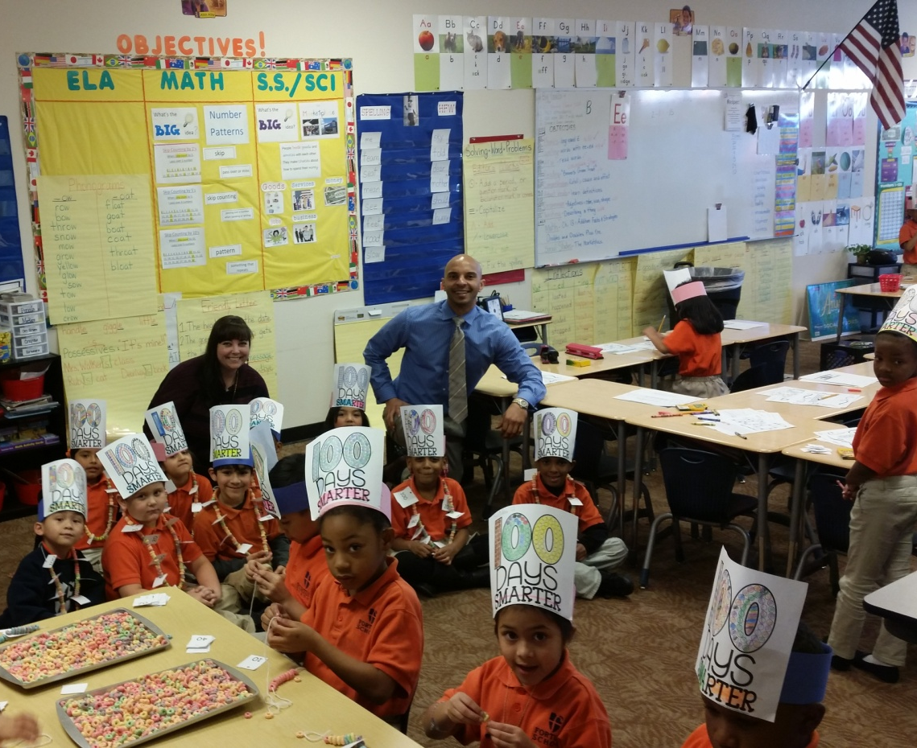
Fortune School

Slide 25
CULTURE
5 Pillars
Branding
External Relations

Slide 26
SUCCESSFUL LEADERSHIP PRACTICES
THE 5 PILLARS:
High Expectations
Choice and Commitment
More Time
Focus on Results
Citizenship

Slide 27
SUCCESSFUL LEADERSHIP PRACTICES
THE 5 PILLARS:
High expectations – for academic achievement and conduct.
Choice and Commitment – everyone chooses to participate in the program, and uphold a commitment to the school and to each other to put in the time and effort required for success.
More time – extended school day, week and year; ensures that students acquire knowledge and skills that prepare them for competitive colleges and opportunities to engage in diverse extra-curricular activities.
Focus on Results – focus on high student performance through standardized tests and other objective measures.
Citizenship – belief that the measure of a person’s success is in what he/she gives to others.

Slide 28
SUCCESSFUL INSTRUCTIONAL PRACTICES
Selection of Teachers
Professional Development
Data-Driven Instruction

Slide 29
SELECTION OF TEACHERS
Understanding of the achievement gap
Classroom management skills
Willingness to use data to guide instruction
Interest in community growth through education

Slide 30
PROFESSIONAL DEVELOPMENT
3 Weeks of Professional Development per year
Focuses on:
California Common Core State Standards
Setting the tone for learning
Technology
Assessment methodology

Slide 31
STUDENT ASSESSMENT
Entry-level diagnostic exam for all students
Progress monitoring
Formative assessments
Summative assessments
End of trimester exams
Smarter Balanced Assessment Consortium

Slide 32
SAMPLE STUDENT ASSESSMENT DATA KINDERGARTEN 2013-14
Source: Houghton Mifflin Harcourt Assessments

Slide 33
OPERATIONS
Staff Selection – Belief in the Mission; School Experience
Office Manager, School Secretary, Parent Liaison, Food Service Coordinator, Campus Monitor, Custodian
Operations Manual; On-going Professional Development; Regular Check-ins
Vendor Relationships

Slide 34
FINANCE
Charter Petition
Budget
Cash Flow Statement
Special Advance Apportionment
37% based on PENSEC (July-Nov State Aid)
18% based on 20 Day Attendance (Dec-Jan Aid)
Cash Flow Options
Charter revolving loan, PCSGP Grant, receivable sales, line of credit/growth loans, charitable giving

Slide 35


Slide 36
KEY TAKE-A-WAYS FROM PARENT COMMENTS (Chapter 4, pp. 181-182)
Parents should develop vocabulary of their children: Read to them before they can talk.
Parents should establish routines at home.
Parents should teach that learning at home takes precedence over TV, video games, and social networks with friends.

Slide 37
CONCLUSIONS
African American & Hispanic students are successful in some schools.
Principals, teachers and other educators should consider successful school strategies.
Parent engagement is essential for student success. Good parenting makes for better schooling that lead to a better community, state and nation
Education is not simply the providence of schools; the broader community needs to be engaged.

Slide 38
CLOSING
“I See A School” Activity
Q & A

Slide 39

www.fortuneandassociates.com
rcfortune9@yahoo.com
(916) 803-4903

